Slide 1
Simio Visio Interface

Slide 2

Agenda
What it is
Demonstration
Architecture
Roadmap

Slide 3

Design Consideration
Consistent with other Intefaces
Work with/without Simio stencils
Consistent with Simio Data-Driven philosophy
No COM or interops. Ready for .NET future.
Simple usage; minimal programming
Does not need Visio or 3rd party software
Leverage standards, software
Defines workflow for future interfaces.

Slide 4

Demo
…

Slide 5
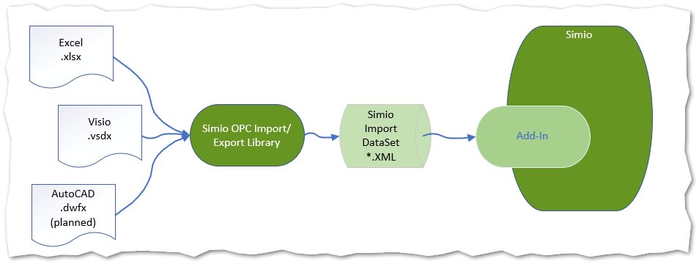
Architecture

Slide 6
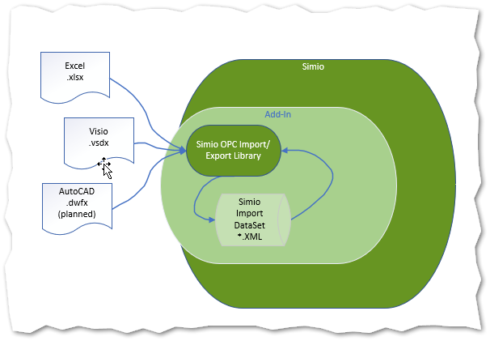
Architecture User’s View

Slide 7
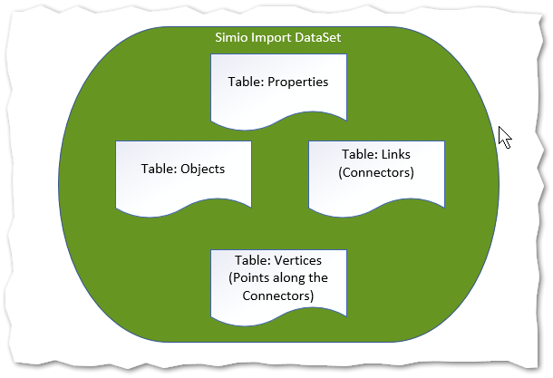
SDX Architecture
Simio Drawing eXchange DataSet

Slide 8

What’s Included
Simio Visio Stencils
All source and binaries for Add-In
Harness program to help with debugging
Accompanying Video

Slide 9
Roadmap
Get feedback, apply, expand as necessary
Demonstrate use with Excel and Delimited
See what Visio 3D looks like

